Slide 1


Slide 2
AGENDA
WHAT IS EC2?
BENEFITS OF EC2?
CASE STUDY: SCIENTIST
WHAT IS AMI?
CASE STUDY: NEWS LETTER
EC2 PRICING MODEL
COMPONENTS OF EC2
ADVANCED EC2

Slide 3
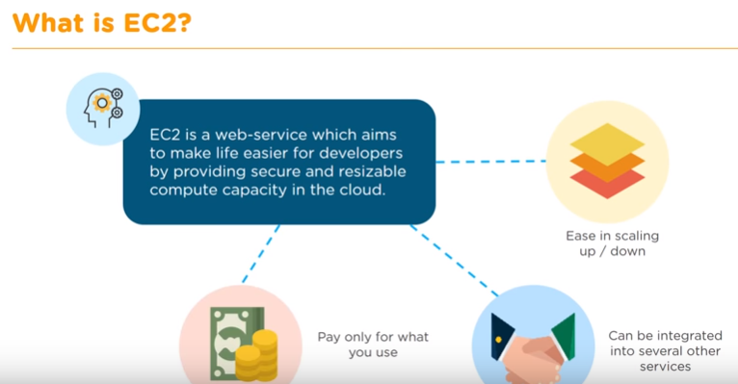
WHAT IS EC2?

Slide 4
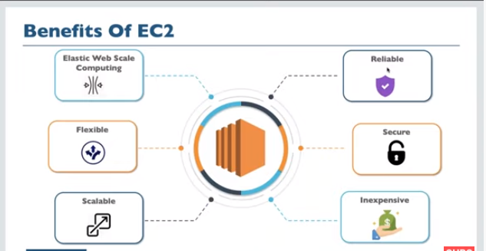
BENEFITS OF EC2
Easier and Faster - Amazon EC2 reduces time required to obtain and boot new server instances to minutes, allowing you to quickly scale capacity, both up and down, as your computing requirements change.
Elastic and Scalable – Quickly add and subtract resources to applications to meet customer demand and manage costs. Avoid provisioning resources upfront for projects with variable consumption rates or short lifetimes.
High Availability – Amazon EC2 provides developers the tools to build failure resilient applications and isolate themselves from common failure scenarios.
Cost-Effective – Consume only the amount of compute, storage and other IT resources needed. No long-term commitment, minimum spend or up-front investment is required.

Slide 5
CASE STUDY: SCIENTIST
REAL TIME CASE STUDY
Problem Statement:
Scientist running his research center in Mumbai, All of Sudden system went down
and he was trying to trouble shoot the instance almost with all the possibilities
But at end, Nothing able to do and recover the system back and this impacted to continue his regular works.
Solution:
Found AWS Cloud computing as a Solution and Created an Instance through EC2.
Benefit of EC2:
Cost Effective
Auto Recovering of Instance is possible
Not Requires any Hardware configuration
Easily Scalable (Up or Down)
Highly Secure
You only pay for what you use
You have complete control
Work-life Balance:
Scientist started perform his research job from Home itself since he is using cloud computing core service EC2

Slide 6
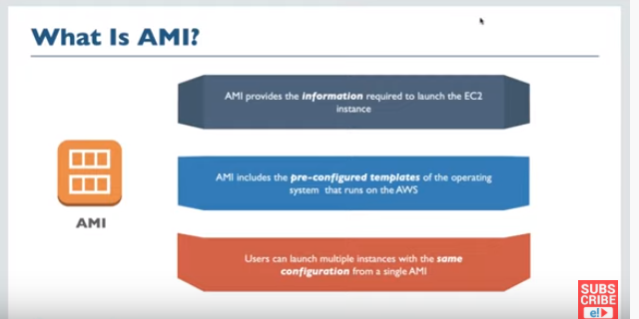
WHAT IS AMI?

Slide 7
EC2 PRICING MODEL
EC2 Pricing Model
Free Usage Tier
On-Demand Instances
Start and stop instances whenever you like, costs are rounded up to the nearest hour. (Worst price)
Reserved Instances
Pay up front for one/three years in advance. (Best price)
Unused instances can be sold on a secondary market.
Spot Instances
Specify the price you are willing to pay, and instances get started and stopped without any warning as the marked changes. (Kind of like Condor!)
Dedicated Instances
Charge for instance
Amazon Elastic Compute Cloud (Amazon EC2) is a web service that provides secure, resizable compute capacity in the cloud. It is designed to make web-scale computing easier for developers.
The Amazon EC2 simple web service interface allows you to obtain and configure capacity with minimal friction. It provides you with complete control of your computing resources and lets you run on Amazon’s proven computing environment.
Amazon EC2 reduces the time required to obtain and boot new server instances (called Amazon EC2 instances) to minutes, allowing you to quickly scale capacity, both up and down, as your computing requirements change.
Amazon EC2 changes the economics of computing by allowing you to pay only for capacity that you actually use. Amazon EC2 provides developers and system administrators the tools to build failure resilient applications and isolate themselves from common failure scenarios.

Slide 8
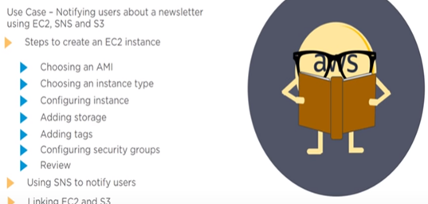
COMPONENTS OF EC2
Requirement:
.pem – PRIVACY ENHANCED MAIL (encrypted and public key)
.ppk - PUTTY PRIVATE KEY FILE (Decrypted Private KEY)
Puttygen - IT CONVERTS PEM TO PPK
Putty - HELPS TO LAUNCH INSTANCE
Pageant – CONTAINER FOR PPK files

Slide 9
THANK YOU

